Slide 1

HTTP
Lecturer: Dr. Bui Ha Duc
Dept. of Mechatronics
Email: ducbh@hcmute.edu.vn

Slide 2
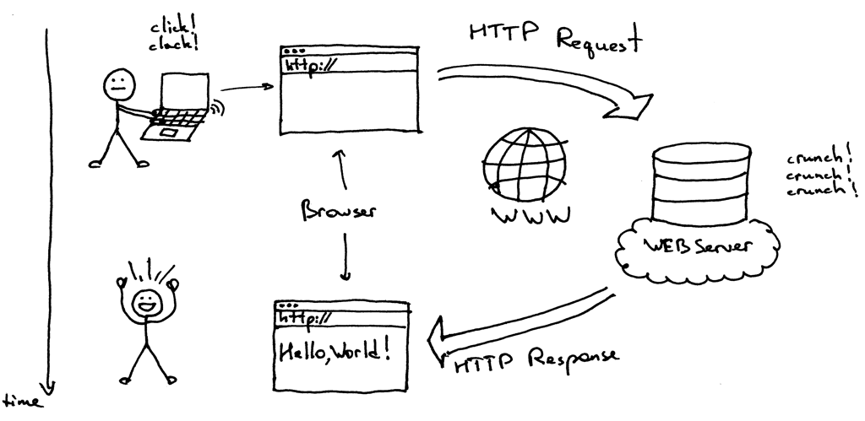
HTTP protocol
https://ruslanspivak.com/lsbaws-part1/
Notes:
In a nutshell it’s a networking server that sits on a physical server (oops, a server on a server) and waits for a client to send a request. When it receives a request, it generates a response and sends it back to the client. The communication between a client and a server happens using HTTP protocol. A client can be your browser or any other software that speaks HTTP.

Slide 3
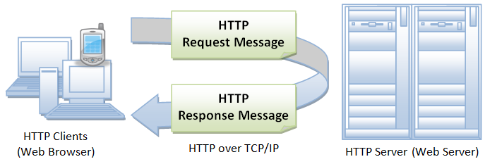
HyperText Transfer Protocol (HTTP)
HTTP is an asymmetric request-response client-server protocol
HTTP is a stateless protocol
http://www.ntu.edu.sg/home/ehchua/programming/webprogramming/http_basics.html

Slide 4
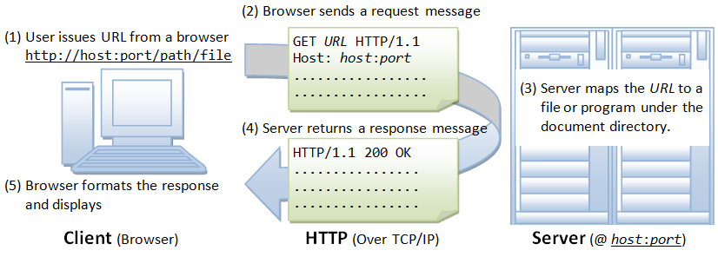
HyperText Transfer Protocol

Slide 5
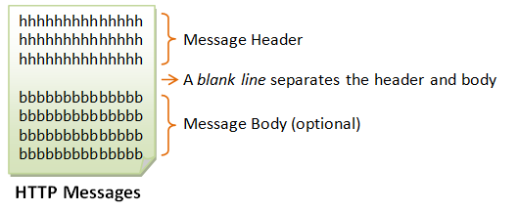
HTTP Messages
HTTP client and server communicate by sending text messages
An HTTP message consists of a message header and an optional message body, separated by a blank line.

Slide 6
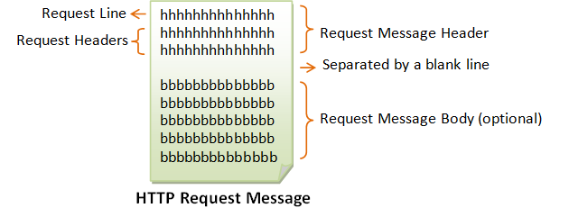
HTTP Request Message
The request line has the following syntax:
request-method-name request-URI HTTP-version
request-method-name: request methods, e.g., GET, POST, HEAD, and OPTIONS.
request-URI: specifies the resource requested.
HTTP-version: Two versions are currently in use: HTTP/1.0 and HTTP/1.1.

Slide 7
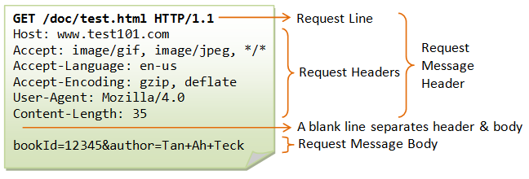
HTTP Request Message
The request headers Syntax:
request-header-name: request-header-value1, request-header-value2, ...
request message body: contain user inputs
name1=value1&name2=value2...

Slide 8
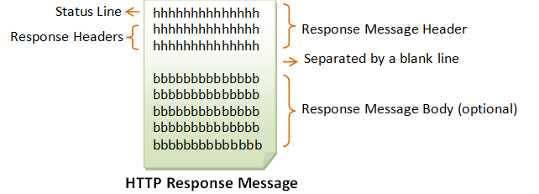
HTTP Response Message
The status line has the following syntax:
HTTP-version status-code reason-phrase
HTTP-version: The HTTP version used in this session. Either HTTP/1.0 and HTTP/1.1.
status-code: a 3-digit number generated by the server to reflect the outcome of the request. (200, 403, 404…)
reason-phrase: gives a short explanation to the status code

Slide 9
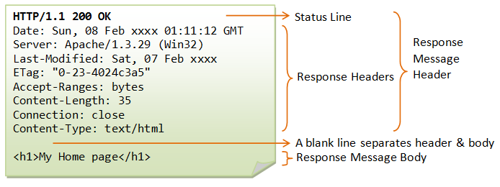
HTTP Response Message
The response headers syntax:
response-header-name: response-header-value1, response-header-value2, ...
Response message body: return value/ website

Slide 10
Example of a web server
https://ruslanspivak.com/lsbaws-part1/
Notes:
In a nutshell it’s a networking server that sits on a physical server (oops, a server on a server) and waits for a client to send a request. When it receives a request, it generates a response and sends it back to the client. The communication between a client and a server happens using HTTP protocol. A client can be your browser or any other software that speaks HTTP.

Slide 11
Creating a web server
Apache Webser:
Most popular web server application
Apache can serve HTML files over HTTP anddynamic web pages using scripting languages such as PHP javascript
Procedures:
Install apache with the command:
sudo apt-get install apache2 –y
Find Raspberry IP with:
hostname -I
Access the website at raspberry IP

Slide 12
Creating a web server
Changing the default web page
The default website is located at:
/var/www/html/index.html
/var/www/html is a enclosed folder, owned by root.
To modify, change the owner with:
sudo chown pi: index.html
Or sudo chown -R pi:pi /var/www/html
Replace the index.html with your website
Notes:
That means that unlike traditional web servers, it does not fork for each incoming connection, nor does it fork many copies of itself to handle multiple connections.

Slide 13
Creating a website
Web developing Languages:
HTML: creating Web pages
CSS: create website layout, describes how HTML elements are to be displayed on screen, paper, or in other media
Javascript: makes website do what you want them to do
PHP: making dynamic and interactive Web pages
Websocket: lightweight client-server communication
Visit www.w3schools.com

Slide 14
Structure of a website
<!DOCTYPE html> <html> <head> <title>Page Title</title> </head> <body> <h1>My First Heading</h1> <p>My first paragraph.</p> </body> </html>
Elements

Slide 15
HTML Elements
HTML element structure:
<tagname>Content...</tagname>
HTML Elements
Start tag
End tag
Start tag | End tag | Function
<h1> | </h1> | Heading text
<p> | </p> | Paragraph
<a link> | </a> | Link address
<img> |  | Image
<table> | </table> | Table
<div> | </div> | Division, contains other elements
<form> | </form> | Defines a form that is used to collect user input

Slide 16
HTML Attributes
Attributes provide additional information about an element.
Attributes are always specified in the start tag
E.g. <a href="https://www.w3schools.com">This is a link</a>
<img src="w3schools.jpg" width="104" height="142">
HTML Attributes:
Attribute | Function
disabled | Specifies that an input element should be disabled
href | Specifies the URL (web address) for a link
id | Specifies a unique id for an element
src | Specifies the source (web address) for an image
style | Specifies an inline CSS style for an element
title | Specifies extra information about an element

Slide 17
The Action Attribute
Example
<form action=“…/mult.cgi">
The action attribute defines the action to be performed when the form is submitted.
In the example above, the form data is sent to a program on the server called “mult.cgi". This program contains a server-side script that handles the form data.
If the action attribute is omitted, the action is set to the current page.

Slide 18
The Method Attribute
The method attribute specifies the HTTP method (GET or POST) to be used when submitting the form data.
e.g. <form action=“…/mult.cgi“ method = “GET”>
<form action=“…/mult.cgi“ method = “POST”>
If GET is used, the data received will be
?m=20&n=3
(data will be show on the url bar)
GET is best suited for short, non-sensitive, amounts of data, because it has size limitations.

Slide 19
The Method Attribute
If POST is used, the data received will be
m=20&n=3
POST has no size limitations, and can be used to send large amounts of data.
Reference
(https://developer.mozilla.org/en-US/docs/Web/Guide/HTML/Forms/Sending_and_retrieving_form_data)

Slide 20
Reading input
Using POST, data is passed to the script or program in the standard input stream (stdin), and the length (in bytes, i.e. characters) of the data is passed in an environment variable called CONTENT_LENGTH.
When reading the input, the program must not try to read more than CONTENT_LENGTH characters.
(Refer to these website for more detail:
https://www.w3schools.com/php/php_forms.asp
https://www.ostraining.com/blog/coding/retrieve-html-form-data-with-php/
)

Slide 21
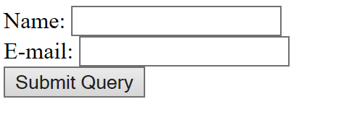
Reading input from POST
<!DOCTYPE HTML> <html> <body> <form action="welcome.php" method="post"> Name: <input type="text" name="name"><br> E-mail: <input type="text" name="email"><br> <input type="submit"> </form> </body> </html>
The data received will be ?
Notes:
Essentially, the program retrieves the information about the number of characters in the input from value of the CONTENT_LENGTH environment variable. Then it unencodes (decodes) the data, since the data arrives in the specifically encoded format that was already men­tioned. The program has been written for a form where the text input field has the name data (actually, just the length of the name matters here). For example, if the user types

Slide 22
Reading input from POST with PHP
// welcome.php
<?php
// retrieve the form data by using the element's name attributes value as key
$name = $_POST[“name];
$email = $_POST[“email”];
// display the results
echo '<h3>Your name is</h3>’ .$name;
echo “<br>”;
echo '<h3>Your email is</h3>’ .$email;
?>

Slide 23
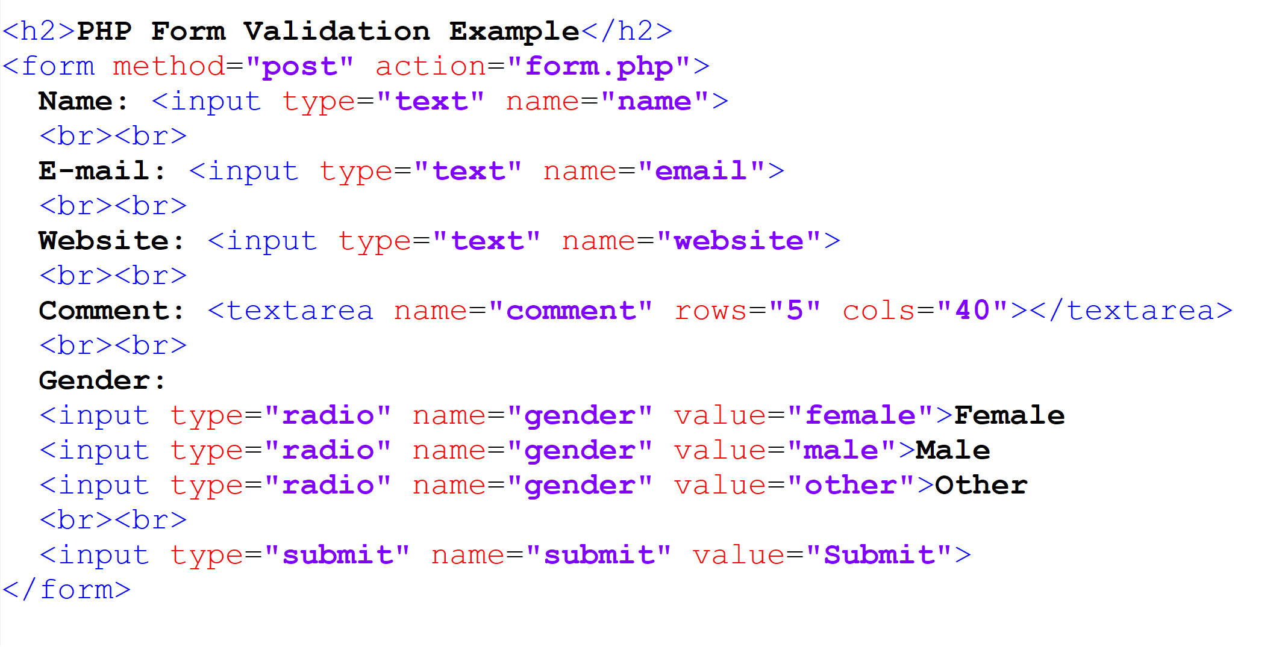
Example
How does this website look like?

Slide 24
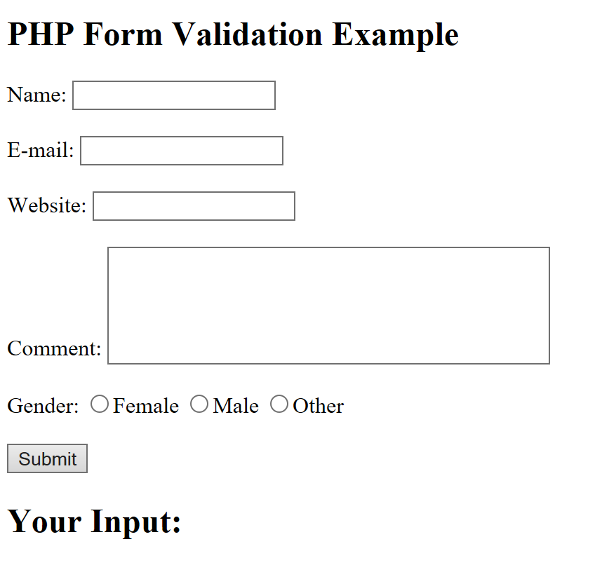
Example
The data received will be ?
Write a php file to read the user input?

Slide 25
